Slide 1
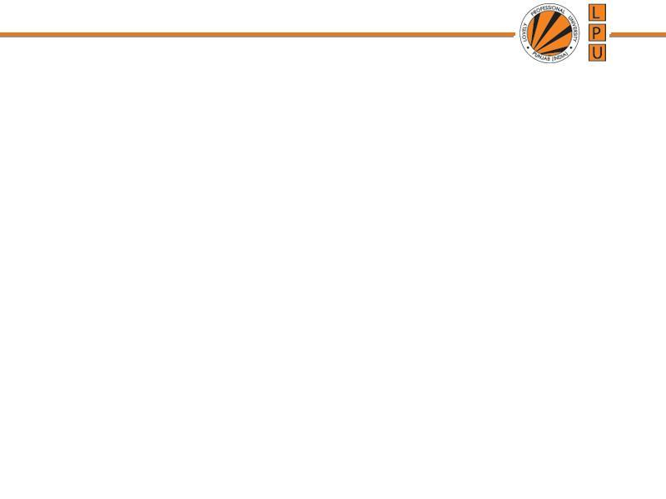
Chapter: Memory Management

Slide 2
Memory
Computer has 2 types of memory:
Main Memory: temporarily stores data and instructions executed by the computer. CPU retrieve instructions from main memory and executes it.
Secondary Memory: directly is not accessed by CPU
Memory addresses:
Absolute address: exact location of byte in RAM
Relative address: Location of byte in RAM is obtained by adding displacement to base address.
e.g. base address: 2000, displacement: 2
Relative address : 2000+2=2002

Slide 3
Address Binding
Address Binding: Assigning an address to data or instruction.
Address binding is a process of generating address where the data/instruction is to be stored in memory.
3 types of address binding:
Compile time binding
Load time binding
Run time binding

Slide 4
Address Binding
Address Binding: Fixing a physical address to the logical address of a process address space
Compile time binding: it is known to compiler at compile time where a program will reside in physical memory
Load time binding: if program location in memory is unknown until run-time.
Execution/Run time binding: If the process can be moved during its execution from one memory segment to another, then binding must be delayed until run time. The absolute addresses are generated by hardware.

Slide 5
Logical and Physical Address Space
1. Logical Address or Virtual address:
a. The address generated by CPU.
b. Logical address is address of instruction / data as used by program at some time.
Physical Address:
It is the address used seen by memory unit.
It refers to actual location in the main memory.
The user can never view physical address of program

Slide 6
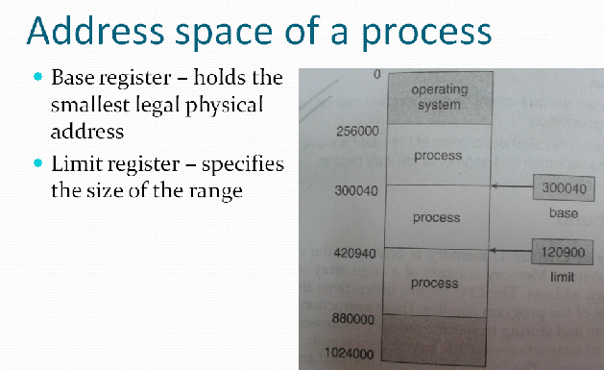

Slide 7
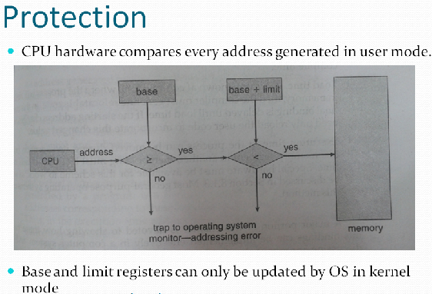

Slide 8
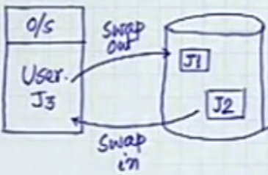
Swapping
For Multi-User System
J3 is completed and put it back to Secondary storage.
b) J3 terminates itself so required to put to Secondary storage.
c) Abnormal Termination due to trap, so bring a new job to CPU

Slide 9
Swapping
Technique of removing a process from main memory and storing it into secondary memory, then bringing it back into main memory for continued execution.
It is a technique used in multiprogramming environments which have limited memory capacity.
Action of moving process out of main memory is called Swap Out
Action of moving process into main memory is called Swap In
Area on the disk where swapped out process are stored is known as Swap Space.

Slide 10
Swapping
During Swap-Out foll. Things are checked:
While in Main Memory was user program modified?
Yes: write it back to Sec. Memory
No: Sec. Memory already has a copy of it, no need to write.
Overwrite J3 with new program. I.e bring new program

Slide 11
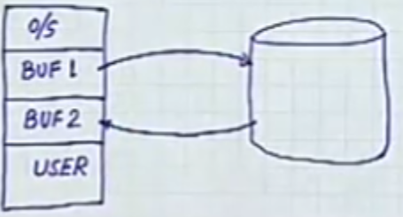
Swapping
Problem: During Swapping I/O or Disk Operations are performed , Which are Slow: So CPU efficiency becomes poor.
Solution: Overlap swapping with CPU execution → needs more partitions in memory
Next Model:

Slide 12
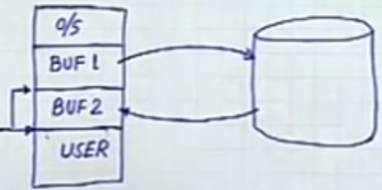
Swapping
BUF 1: (Swap – Out)
Stores User Programs that are
completed and required to be
placed into Sec. Memory
BUF 2: ( Swap – In)
Stores User programs which needs execution
User Area: Contains programs which are currently executed by CPU, Active Programs.

Slide 13
Swapping
User Program can try to access BUF areas ,
So Need: Fence Address
To speed up processing
Shift Fence Address instead of
Shifting blocks
Program from BUF2 can directly be executed instead of shifting to user block

Slide 14
Partition Allocation
One method of allocating contiguous memory is to divide all available memory into equal sized partitions, and to assign each process to their own partition.
Partition Allocation Algorithms:
First Fit:
Checks all partitions serially
When partition with size = or > encounters, it is allocated for storage.

Slide 15
Partition Allocation Algorithms
b) Best Fit: This approach will check all the free partitions and will allocate that free partition to a process which leads to minimum internal fragmentation.
Disadvantage:
Complexity is more
Overhead to check all the partitions to find best suitable space
c) Worst Fit: Allocate the largest memory hole

Slide 16
Overlay
Keep only those instructions and data into the memory that are needed at some time.
Overlay of instructions or data is needed when process is larger than amount of memory allocated to it.
It is implemented by user, No special support is needed from the OS.
Complex to implement.

Slide 17
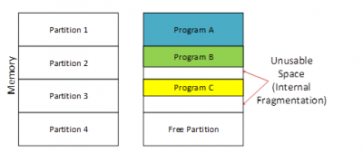
Fragmentation
1. Internal Fragmentation: memory is allocated in blocks of a fixed size, whereas the actual memory needed will rarely be that exact size.
Partition of greater size is allocated to process of small size, rest of the space of that partition is wasted.

Slide 18
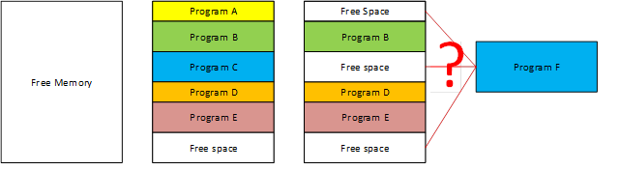
Fragmentation
External Fragmentation: means that the available memory
is broken up into lots of little pieces, none of which is big
enough to satisfy the next memory requirement, although
the sum total could.
Due to non utilization of space, even space is empty

Slide 19
Fragmentation
For Fixed sized partitions
There is:
Internal Fragmentation
External Fragmentation
For Variable sized partitions
There is:
External Fragmentation

Slide 20
Memory Allocation Schemes
Contiguous Memory Allocation
Paging
Segmentation

Slide 21
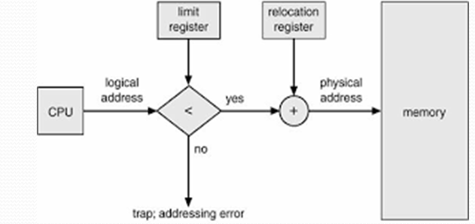
Contiguous Memory Allocation
Each process is contained in a single contiguous section of memory.
Memory Mapping and Protection
Relocation Register: Contains value of smallest physical address
Limit/ Relocation Register: contains range of logical addresses

Slide 22
Problem
Suppose value of relocation register is 100040 and limit register is 74600. What is the physical address for following logical addresses?
70,000 b) 75,000
Sol.
1. Check whether logical address < limit register value?
70,000 < 74,600? TRUE
Physical address= Logical address + Relocation register value
Physical address= 100040 + 70000 = 170040
2. Check whether logical address < limit register value?
75000< 74600? FALSE
Trap: addressing error

Slide 23
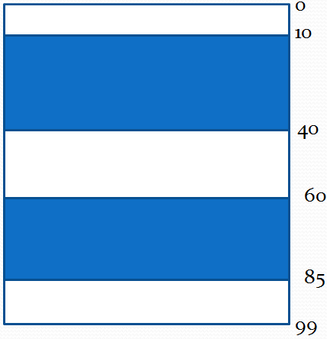
Memory Allocation - Example
Given 3 free memory partitions of 10KB, 20 KB and 15KB ( in order) How would each of the first-fit, best- fit and worst fir algorithms place processes of 15KB, 10KB, 20KB and 5KB (in order)

Slide 24
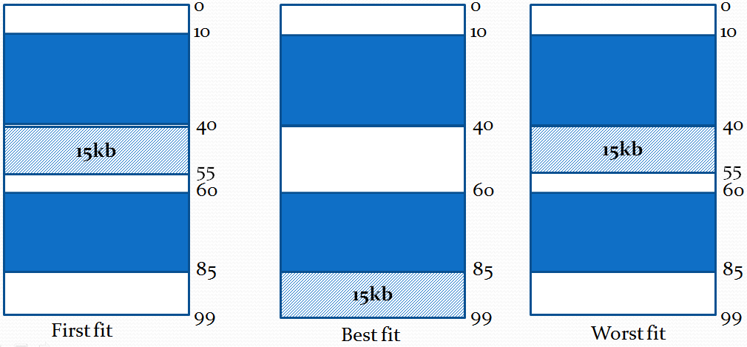
Memory Allocation - Example
For 15KB

Slide 25
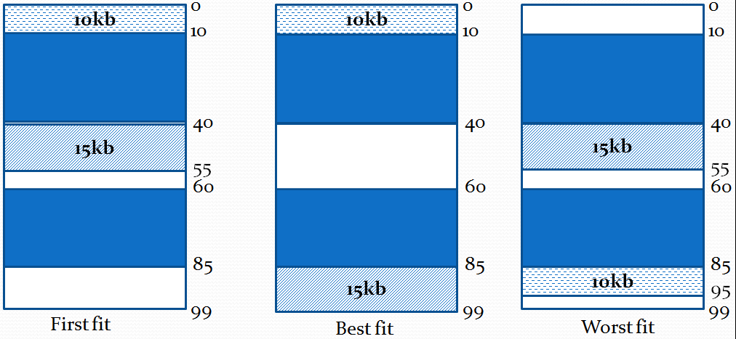
Memory Allocation - Example
For 10KB

Slide 26
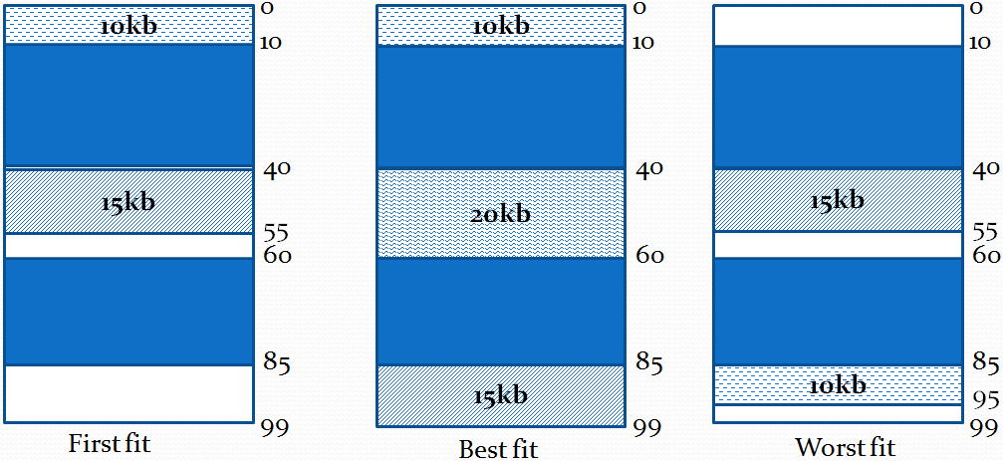
Memory Allocation - Example
For 20KB

Slide 27
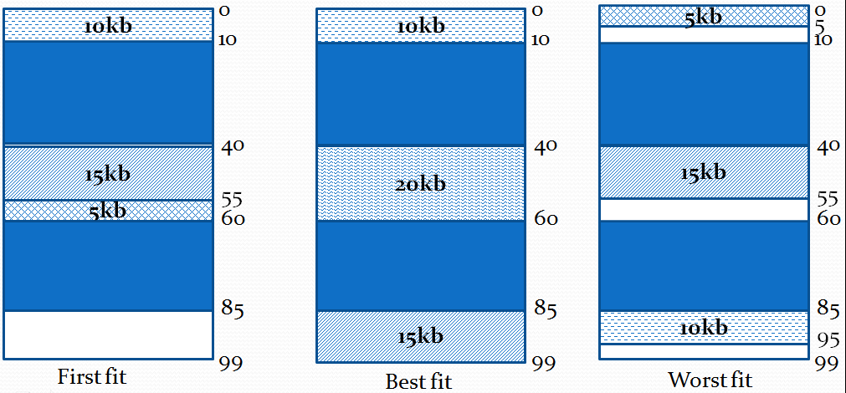
Memory Allocation - Example
For 5KB

Slide 28
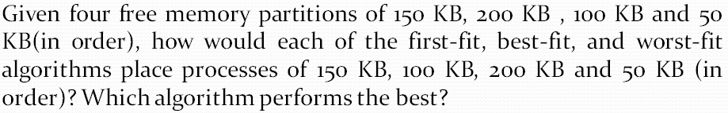
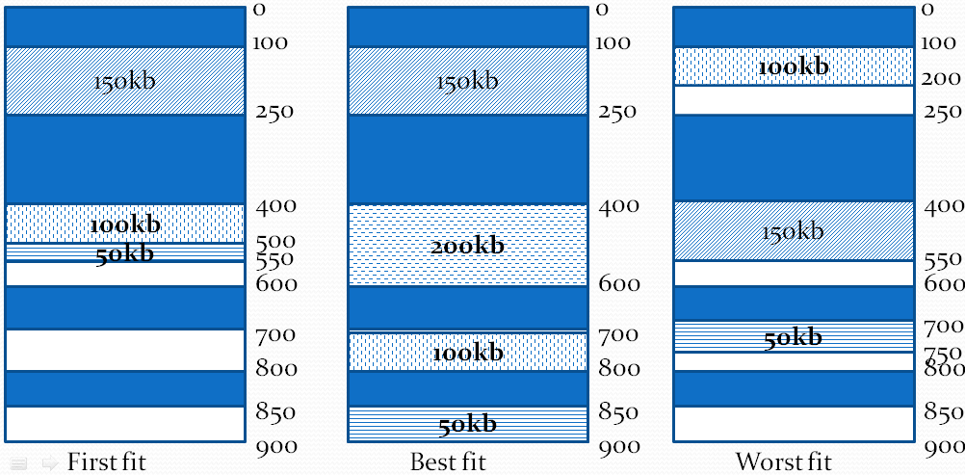
Memory Allocation - Example

Slide 29
Paging / Paged Memory Management
Paging is a memory management scheme that allows
processe’s physical memory to be discontinuous, and
eliminates problems with fragmentation by allocating
memory in equal sized blocks known as pages.

Slide 30
Paging / Paged Memory Management
Every process is divided in to number of pages
Memory is divided into partitions whose size is same as page size : frames
Each frame has frame no.
Page size is same as frame size
Put any page in any free frame
Paging allows non-contiguous memory allocation
Page numbers, frame numbers and frame sizes are determined by the machine architecture
Paging leads to Internal and External Fragmentation
Pages size and Frame size is always in powers of two

Slide 31
Paging / Paged Memory Management
CPU generates logical address and put the pages into random frames
Mapping is required to map which page is stored in which page number
From frame no. physical address could be found

Slide 32
Paging / Paged Memory Management
Physical address space of a process in non- contiguous
Implementation:
Frames: Fixed sized blocks of the physical memory
Pages: Fixed sized slots of the logical memory
When a process is to be executed, its pages are loaded into any available memory frames.
Page Table: To translate logical address to physical address
CPU generated logical addresses to fetch the instructions.

Slide 33
Address Translation
Address generated by CPU is divided into:
a) Page Number (p): used as an index into page table, which contains base address of each page in the physical memory.
b) Page Offset (d): combined with base address to define physical memory address that is sent to the memory unit.
Actual address of any byte in page or frame (Position of instruction in page or frame)
Address of physical memory, where page resides.
The number of bits in the offset determines the maximum size of each page, and should correspond to the system frame size.

Slide 34
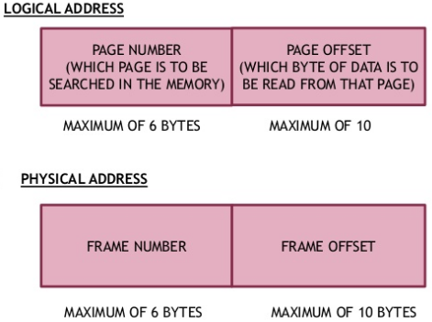
Address Translation

Slide 35
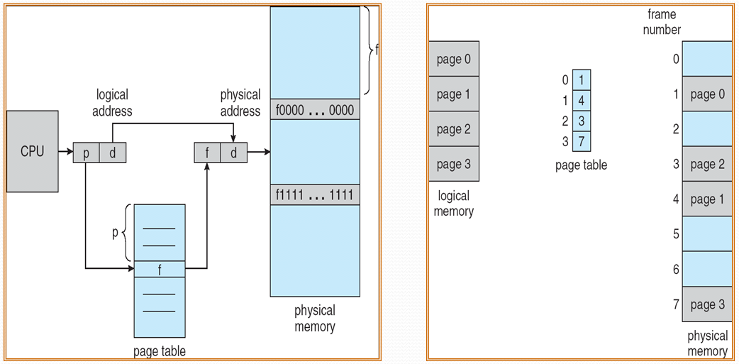
Address Translation

Slide 36
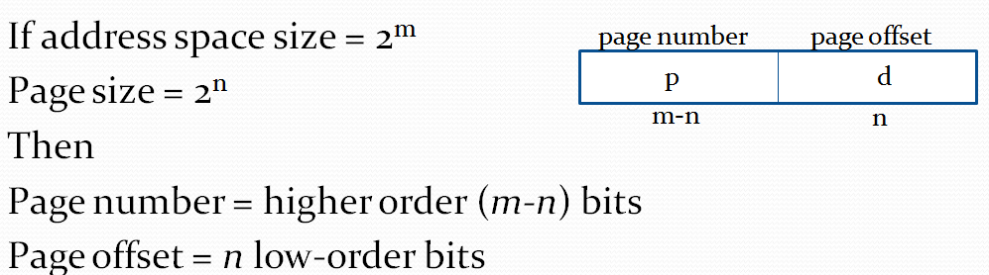
Address Translation
How to break logical address into page number and page offset?
Physical Address= frame x page size + offset

Slide 37
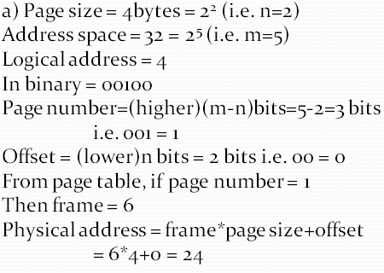
Example
Q. Using a page size of 4 bytes and physical memory of 32 bytes, find the physical address if logical address is:
4
10
Solution:

Slide 38
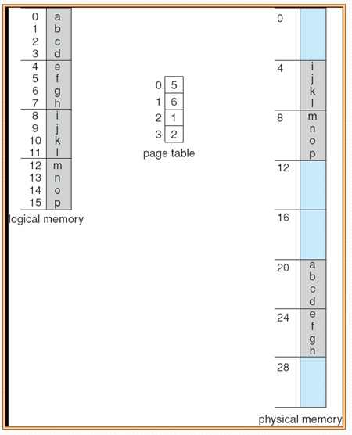
Example- Page Table

Slide 39
Hardware Support: for Page Table Implementation
Structure of Page Table:
Locate page table for each process
Pointer to page table is stored with other register values (e.g. instruction pointer) in PCB.
When dispatcher starts a process, It:
Reload user register
Define correct hardware page table value from stored user table
Page lookups must be done for every memory reference, and whenever a process gets swapped in or out of the CPU, its page table must be swapped in and out too, along with the instruction registers.

Slide 40
Hardware Support: for Page Table Implementation
Methods
One option is to use a set of registers for the page table (256 entries only)
An alternate option is to:
Store the page table in main memory, and to use a single register ( called the page-table base register, PTBR ) to record where in memory the page table is located.
Process switching is fast, because only the single register needs to be changed.
The address of a page table in memory is pointed by: page table base register
Every memory access requires two memory accesses –
One to fetch the frame number from memory
Another one to access the desired memory location.

Slide 41
Hardware Support: for Page Table Implementation
Solution to two memory accesses:
Use a very special high-speed memory device called the translation look-aside buffer, TLB.
The benefit of the TLB is that it can search an entire table for a key value in parallel, and if it is found anywhere in the table, then the corresponding lookup value is returned.
TLB is not large enough to hold the entire page table.
So used as a cache device.
The percentage of time that the desired information is found in the TLB is termed the hit ratio.
The percentage of time that the desired information is not found in the TLB is termed the miss ratio.

Slide 42
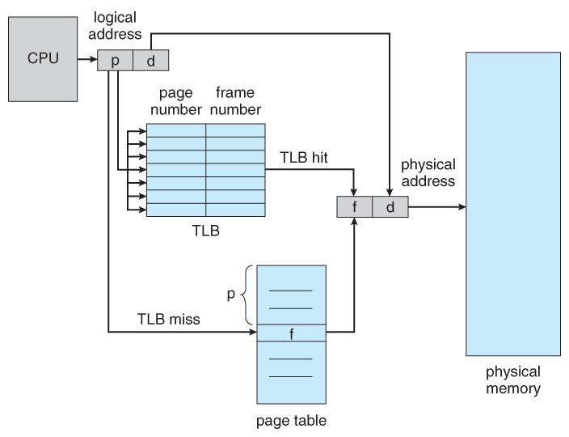
Paging hardware with TLB

Slide 43
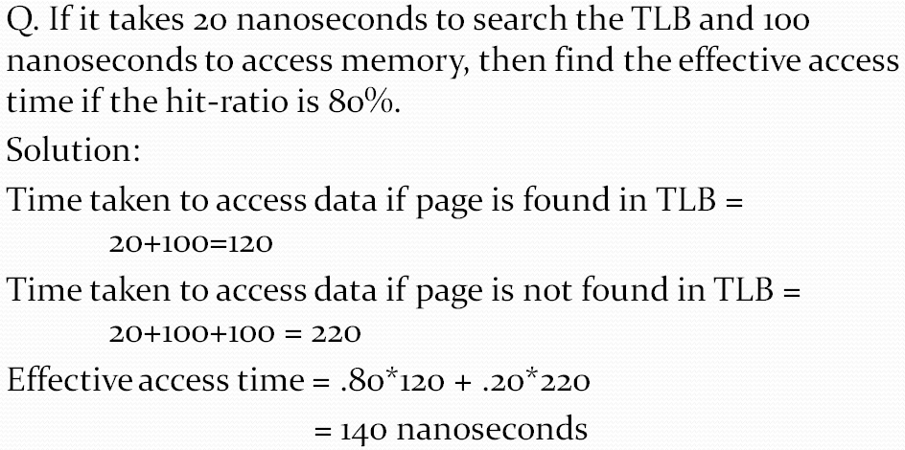
Example
40% slowdown to get the frame

Slide 44

Example
TLB hit takes 120 nanoseconds total ( 20 to find the frame number and then another 100 to go get the data )
TLB miss takes 220 ( 20 to search the TLB, 100 to go get the frame number, and then another 100 to go get the data.
Effective access time = hit ratio x time taken for TLB hit + miss ratio x time taken for TLB miss

Slide 45
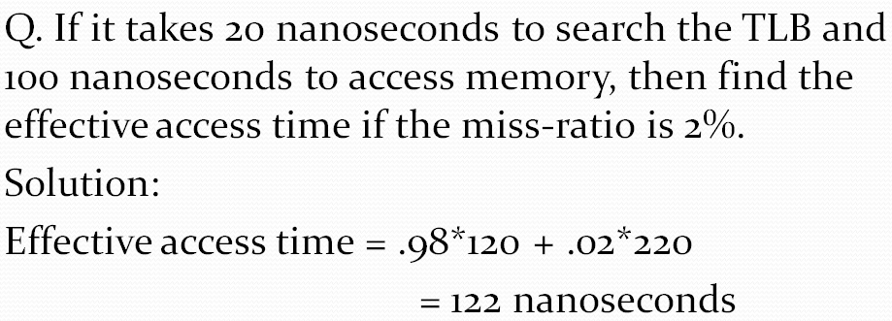
Problem

Slide 46
Memory Protection
It is accomplished by Protection Bits associated with each frame → Valid – Invalid Bit
These bits are kept in page table
Every reference to the memory goes through page table and finds correct frame number.
When bit is set to valid: indicates that associated page is in process's logical address space and is valid page.
When bit is set to invalid: indicates that associated page is not in process's logical address space and is invalid page.

Slide 47
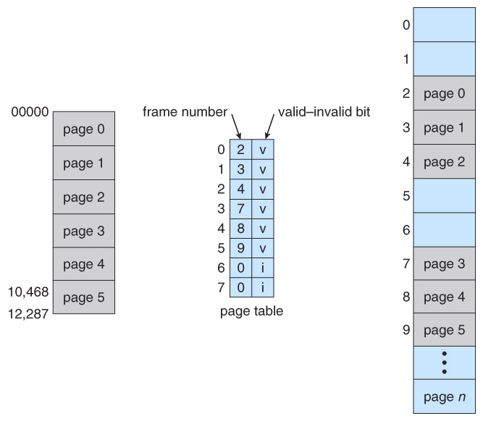
Memory Protection

Slide 48
Segmentation
It is a memory management scheme in which the memory allocated to the process is non contiguous
Logical address space is divided into number of small blocks called segments
Segments are of variable sized

Slide 49
Segmentation
Users view memory as a collection of variable size segments. With no necessary ordering of these segments
Segmentation is memory-management scheme that supports user view of memory
A program is a collection of segments. A segment is a logical unit such as:
main program, function, object, local variables, global variables, data structures : stack, symbol table, arrays

Slide 50
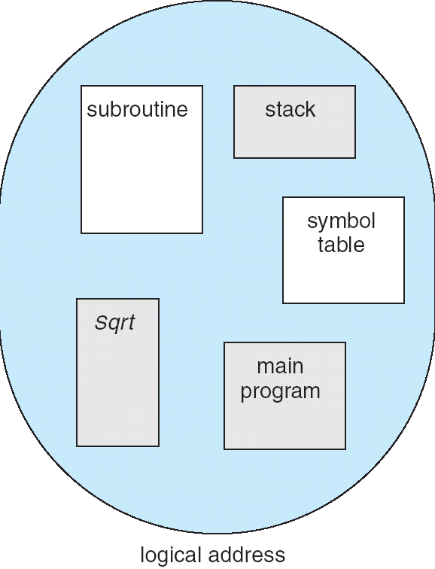
User’s View of a Program

Slide 51
Logical View of Segmentation
1
1
4
2
3
2
4
3
user space
memory space

Slide 52
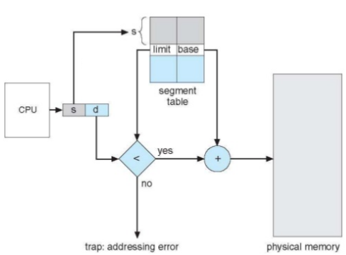
Address Translation:Segmentation

Slide 53
Segmentation Architecture
Each segment has a name and its length.
Logical address consists of a two tuple:
<segment-number, offset>,
Segment table – maps physical addresses; each table entry has:
base – contains the starting physical address where the segments reside in memory
limit – specifies the length of the segment
Segment-table base register (STBR) points to the segment table’s location in memory
Segment-table length register (STLR) indicates number of segments used by a program;
segment number s is legal if s < STLR

Slide 54
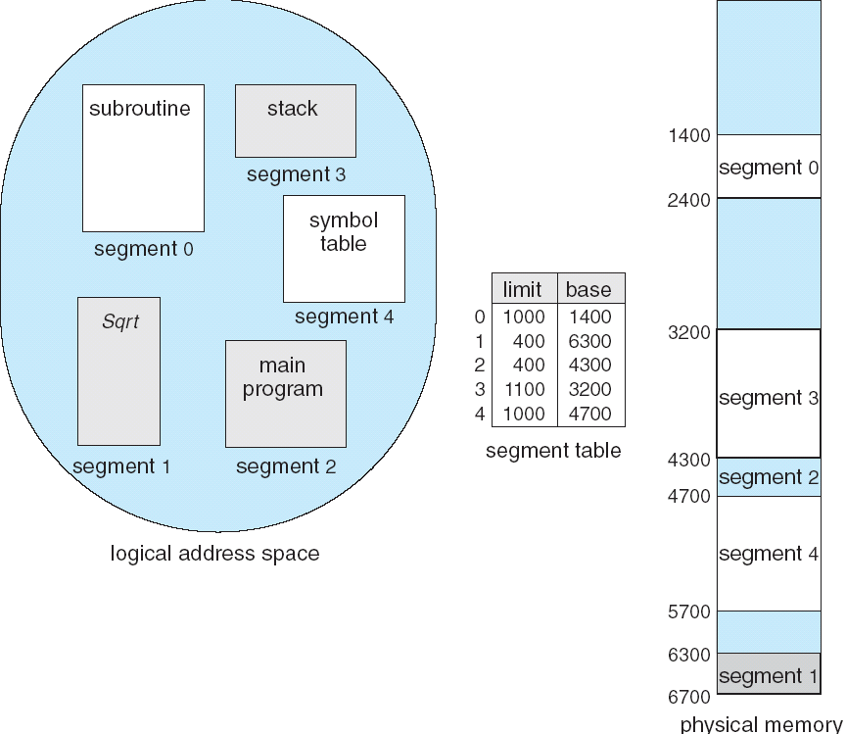

Slide 55
Address Translation:Segmentation

Slide 56
Problems
Q1. if Segment 2 is 400 bytes long and begins at location 4300, then a reference to byte 53 of segment 2 is mapped onto location?
Ans: base address: 4300
Limit: 400
53<400 (I.e limit)
4300+53=4353.

Slide 57
Problems
Q2. A reference to byte 852 of segment 3 is mapped to?
Ans: 3200+852=4052.
Q3. A reference to byte 1222 of segment 0 is mapped to?
Ans: would result in a trap to OS, as this segment is only 1000 bytes long.

